Slide 1
Adversarial Examples In The Physical World (BIM/IFGSM)
Alexey Kurakin Google Brain
2020年6月7日

Slide 2
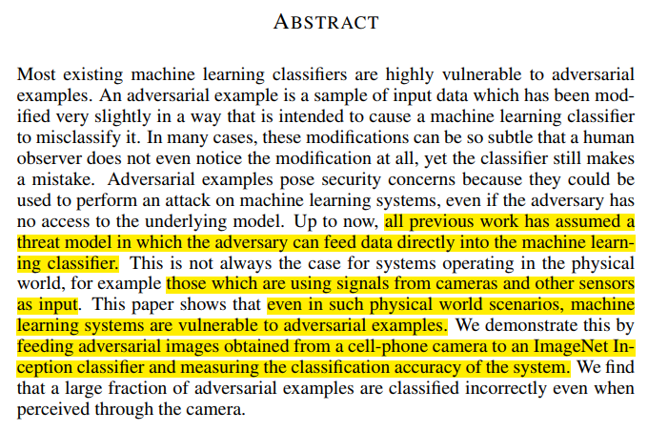
— Adversarial Examples In The Physical World

Slide 3
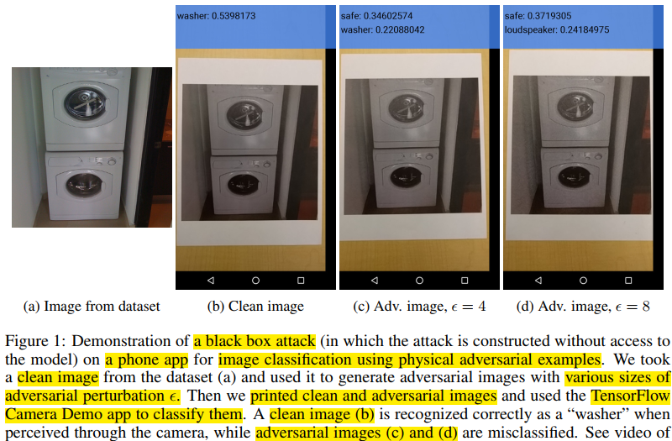
黑盒攻击
— Adversarial Examples In The Physical World

Slide 4


符号定义
正无穷范数：向量的所有元素的绝对值中最大的。
负无穷范数：向量的所有元素的绝对值中最小的。
Clip的功能是保证修改后的像素即在[0,255]区间，又在原像素的$ε邻域。$
— Adversarial Examples In The Physical World

Slide 5



Adversarial Example 生成法
（1）Fast Method【无目标攻击】（即FGSM，一次后向传播，Fast是因为不需要迭代）
（2）Basic Iterative Method【无目标攻击】 （迭代次数启发式选择）
（3）Iterative Least-likely Class Method【大差异（最不可能class）有目标攻击】（🐕→✈）
往损失函数的负梯度方向迭代
$$=$$
— Adversarial Examples In The Physical World

Slide 6
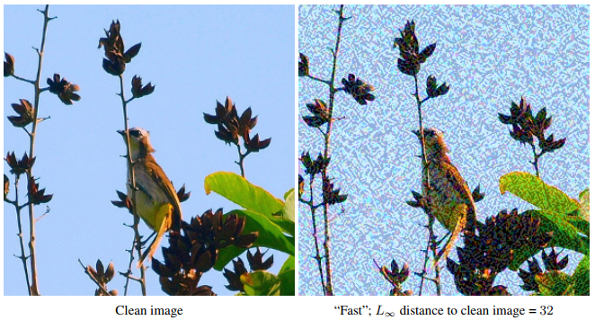
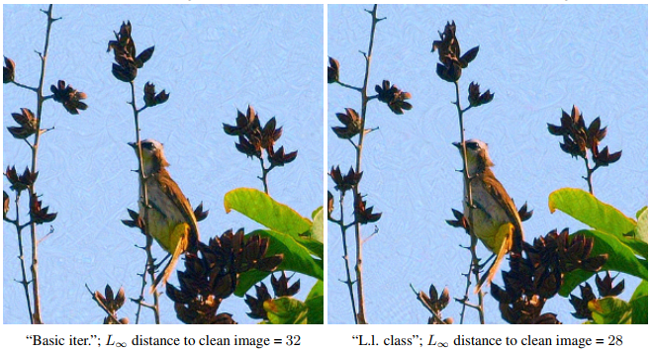
examples of adversarial images produced by different adversarial methods
— Adversarial Examples In The Physical World

Slide 7
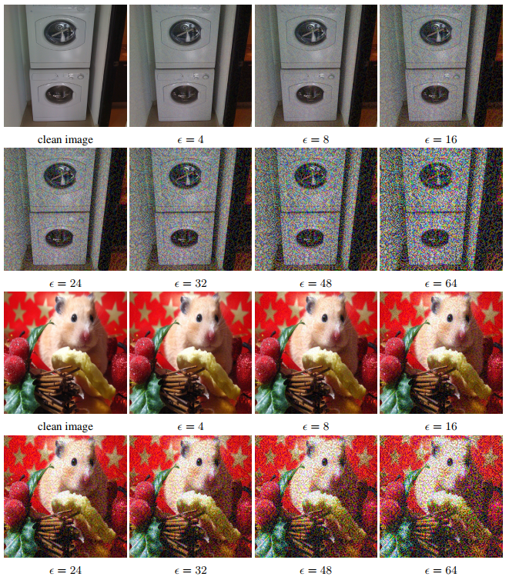

examples of adversarial images for various values of $ε$
— Adversarial Examples In The Physical World

Slide 8
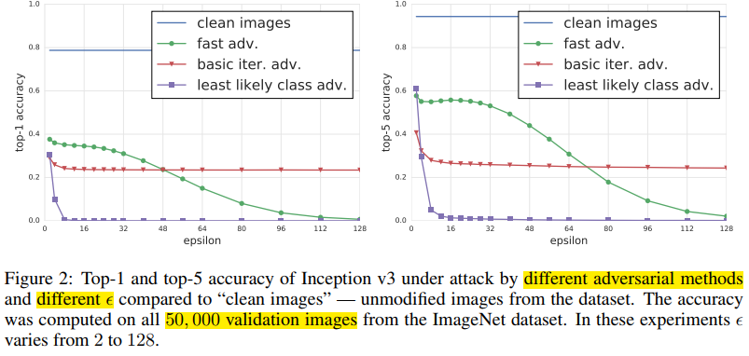
分类准确率
— Adversarial Examples In The Physical World

Slide 9


破坏率
指示符函数
— Adversarial Examples In The Physical World

Slide 10
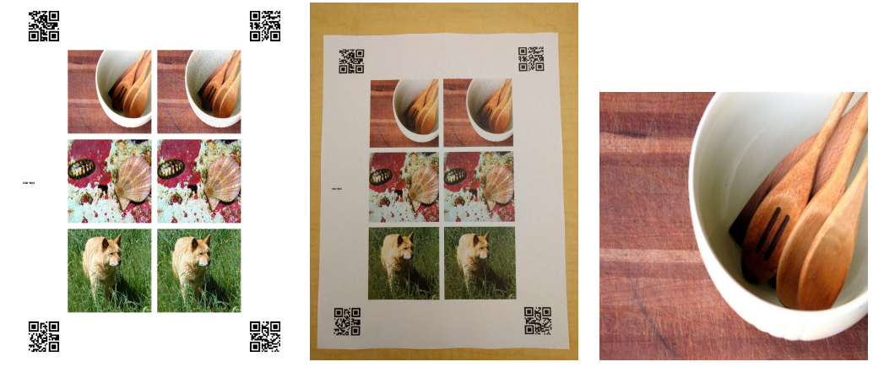
打印对抗样本
— Adversarial Examples In The Physical World

Slide 11
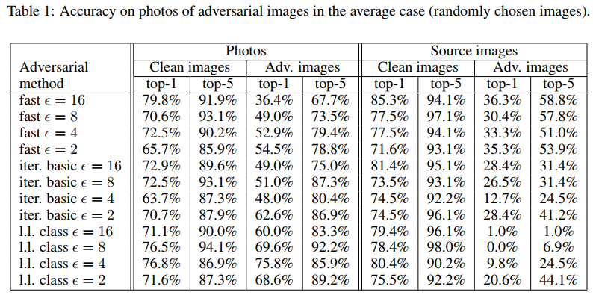
打印对抗样本分类准确率
“fast” adversarial images are more robust to photo transformation compared to iterative methods.原因：跌打法用了很多subtle 扰动，这些扰动易被photo transformation破坏掉。
— Adversarial Examples In The Physical World

Slide 12
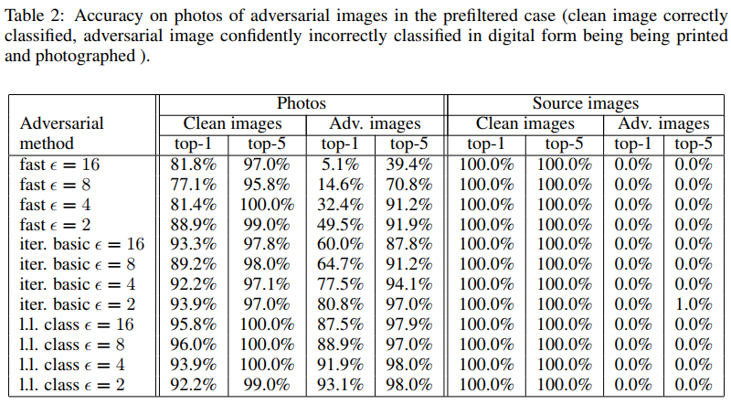
打印对抗样本分类准确率
— Adversarial Examples In The Physical World

Slide 13
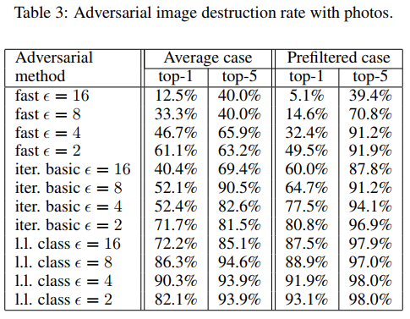
打印对抗样本分类准确率
the adversarial destruction rate in the “prefiltered case” was higher compared to the “average case”
— Adversarial Examples In The Physical World

Slide 14
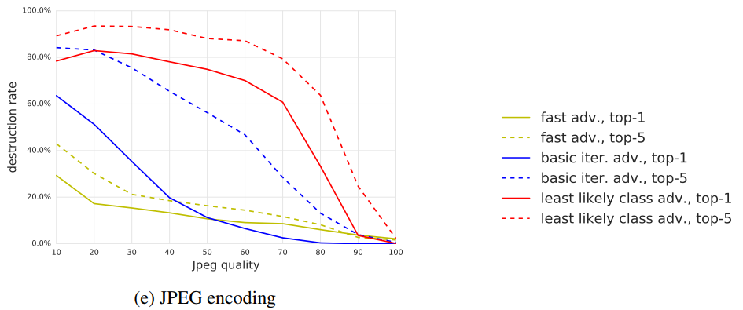
不同图像变换
the fast method are the most robust to transformations
— Adversarial Examples In The Physical World

Slide 15
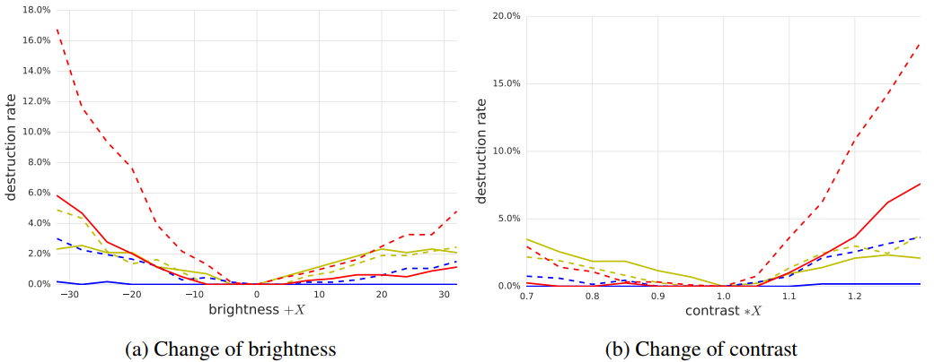
不同图像变换
Changing brightness and contrast does not affect adversarial examples much.
— Adversarial Examples In The Physical World

Slide 16
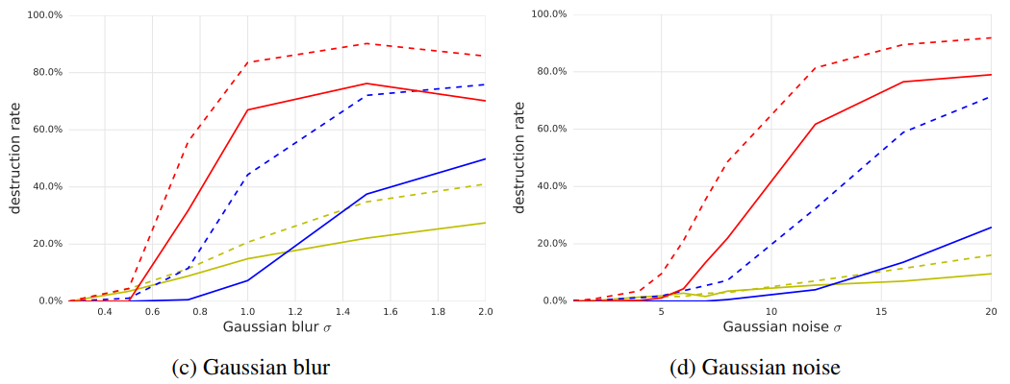
不同图像变换
Blur, noise and JPEG encoding have a higher destruction rate
— Adversarial Examples In The Physical World

Slide 17
总结
迭代版FGSM对于现实世界中的photo transformation更脆弱
有目标攻击跟无目标攻击扰动叠加符号正好相反。
提出黑盒攻击其他分类模型。
提出破坏率destruction rate定义，物理意义是什么？。

